Slide 1
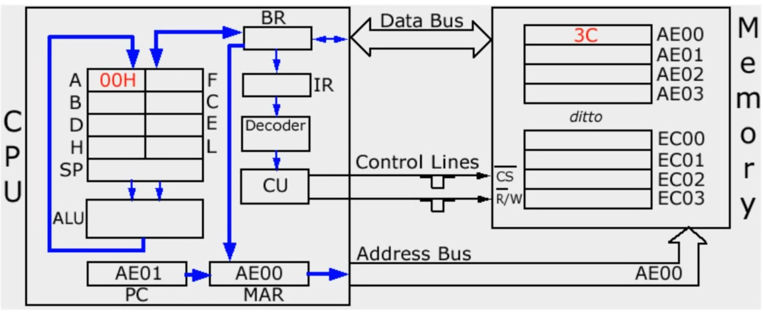
提取-译码-执行 循环[Fetch-Decode-Execute Cycle]
缓冲寄存器[Buffer Register]
指令寄存器[Instruction Register]
随机存取存储器[RAM]
data
address
堆栈寄存器[stack register]
程序计数器[Program Counter]
地址寄存器[Memory Address Register]
算数逻辑单元[Arithmetic&logical Unit]

Slide 2
